Slide 1
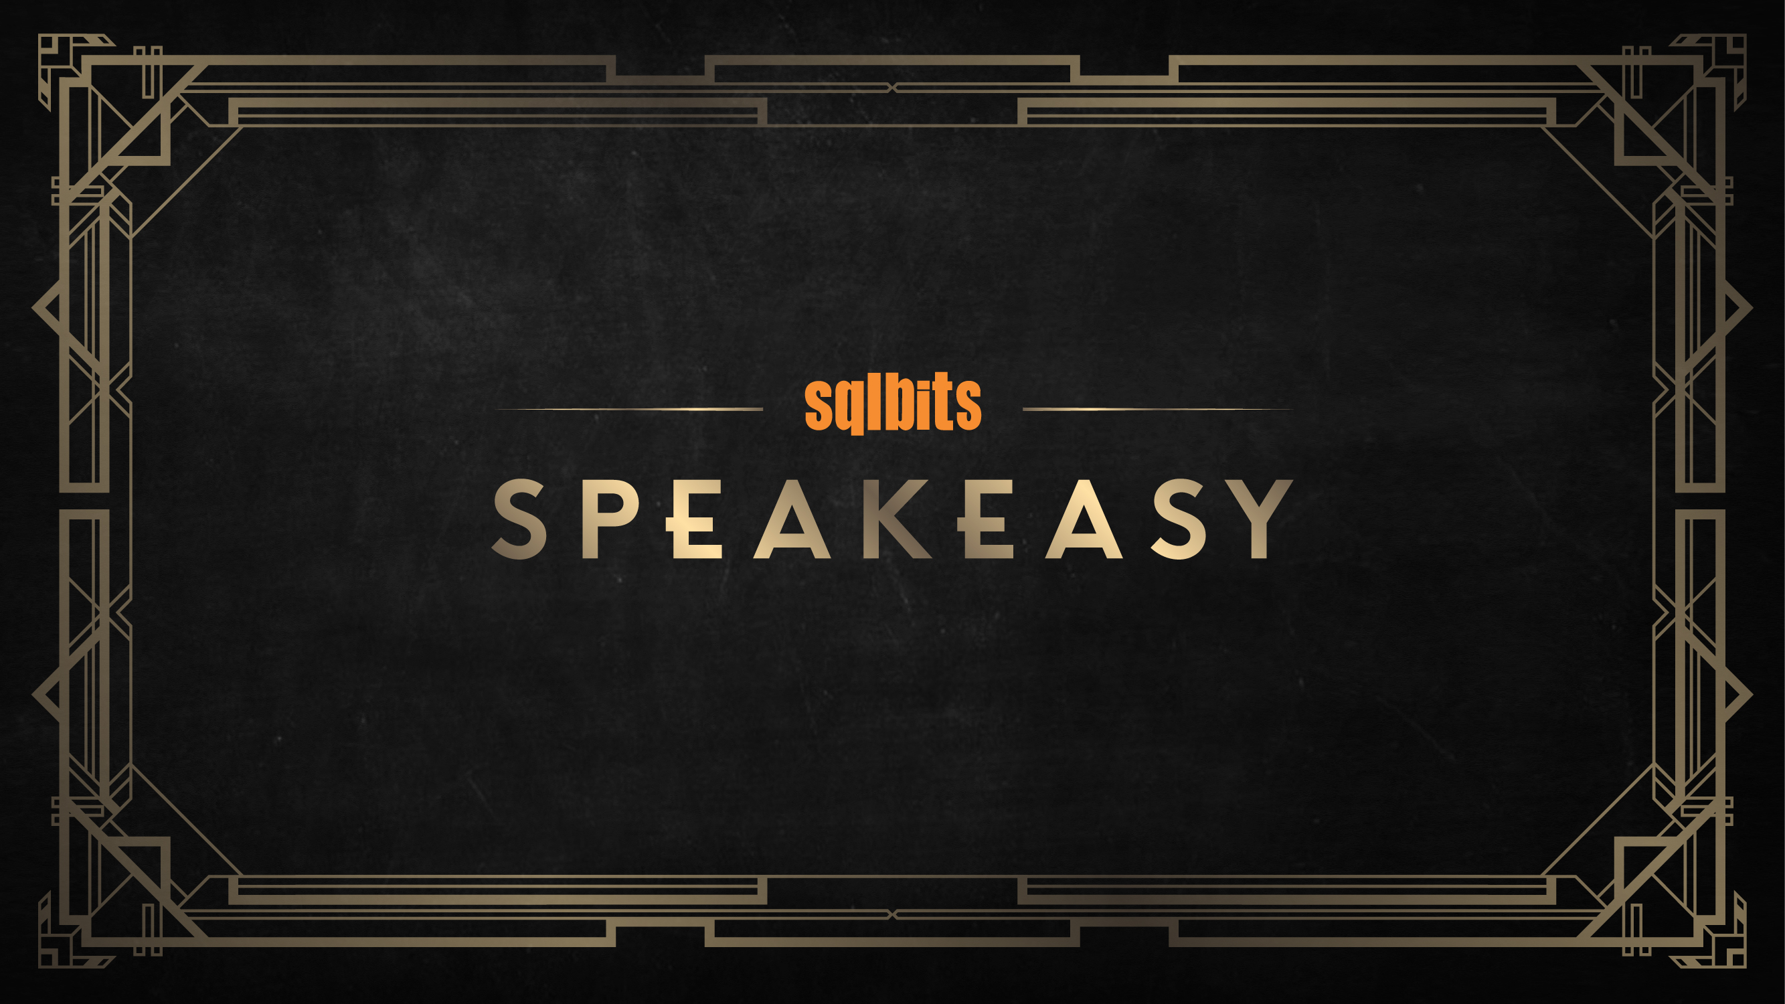

Slide 2


Slide 3

Rich Benner
SQL Server Performance Specialist
@RichBennerSQL
rich@richbenner.com
Richbenner.com

Slide 4
Introduction to ADS
“Azure Data Studio is a cross-platform database tool for data professionals using the Microsoft family of on-premises and cloud data platforms on Windows, MacOS, and Linux.
Previously released under the preview name SQL Operations Studio, Azure Data Studio offers a modern editor experience with Intellisense, code snippets, source control integration, and an integrated terminal. It is engineered with the data platform user in mind, with built in charting of query result sets and customizable dashboards.“

Slide 5
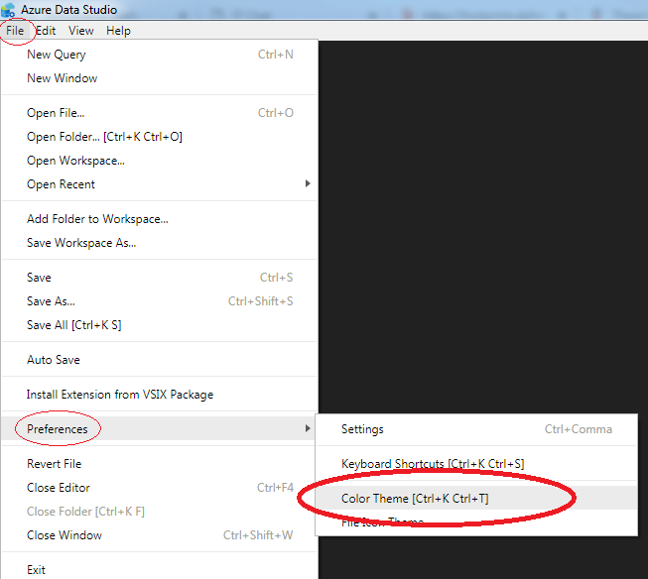
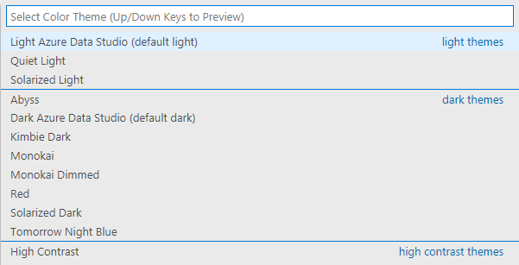
The most important thing
Themes

Slide 6
Connection Management
Connecting to instances
Organising your connections
Major advantage over SSMS if you have a large server estate

Slide 7
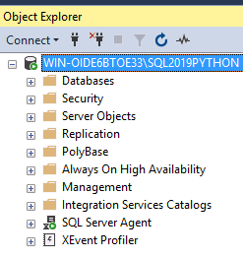
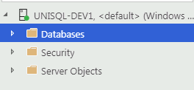
T-SQL Editor & Code Snippets
Functionality very much like SSMS
You can create the same queries and objects that SSMS uses

Slide 8

Command Palette
This is how you do everything
Get used to it buddy

Slide 9
Execution Plans
Estimated Plans - Easy
Actual Plans – Tricky
Bugs in Actual Plans - https://github.com/Microsoft/azuredatastudio/issues/2663

Slide 10
Dashboards
Customisable
Database & Server level
Create widgets for you
Notes:
Run CPU Usage.sql
Create chart (right)
Create insight (top left)
Copy JSON
Ctrl+comma
Search for ‘dashboard’

Slide 11

Extensions
Fully Supported
Anybody can make one
BUT, anybody can make one…

Slide 12
Integrated Terminal
You can run: Cmd, Powershell, bash
Native
Set the default you want

Slide 13
Source Control
GIT integration
You do need GIT installed

Slide 15
richbenner.com/studio
SQLSlack.com – SQL Server Community Slack Channel
Rich Benner
Twits: @RichBennerSQL
Email: rich@richbenner.com

